Slide 1
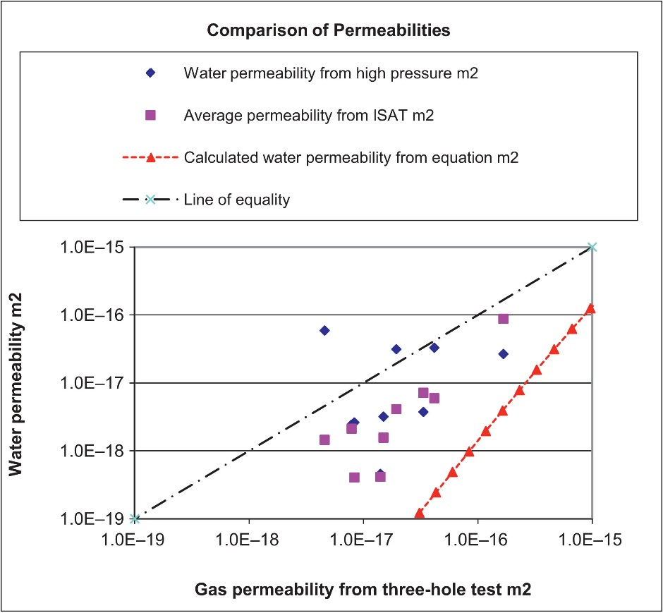
FIGURE 15.1 Comparison of Permeability Results

Slide 2
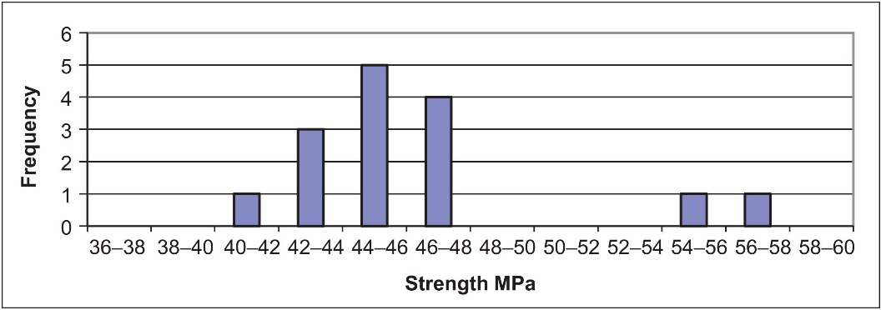
FIGURE 15.2 Frequency Histogram for Concrete Cubes

Slide 3
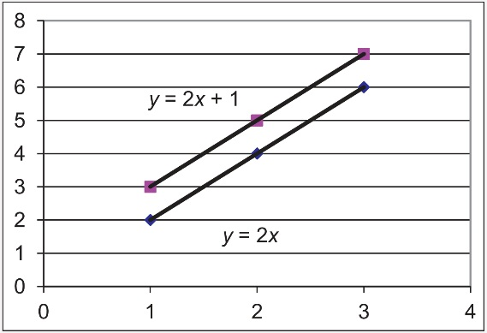
FIGURE 15.3 Line Fits to Two Data Sets

Slide 4
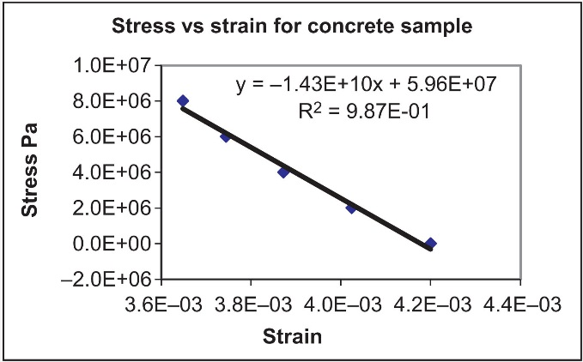
FIGURE 15.4 Regression Line

Slide 5
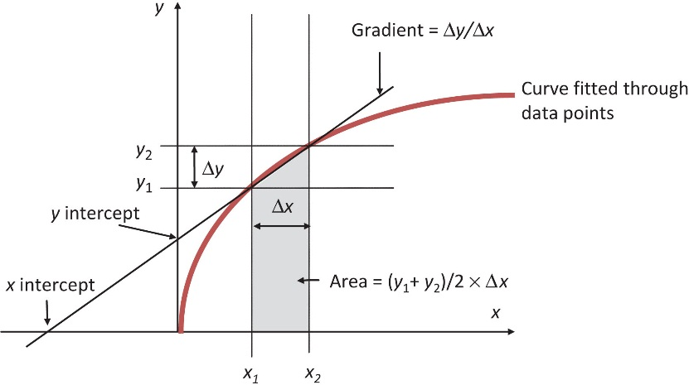
FIGURE 15.5 Gradient of a Curve

Slide 6
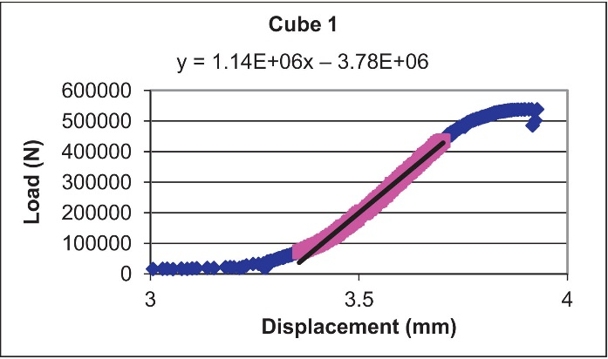
FIGURE 15.6 Typical Cube Test Results

Slide 7
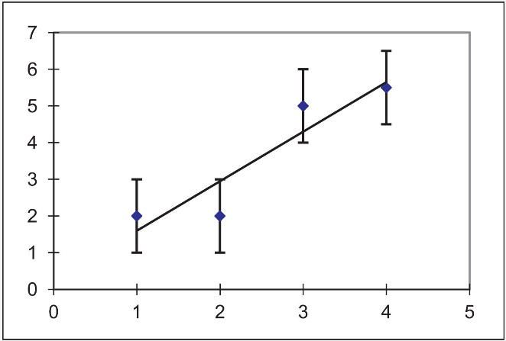
FIGURE 15.7 Error Bars

Slide 8
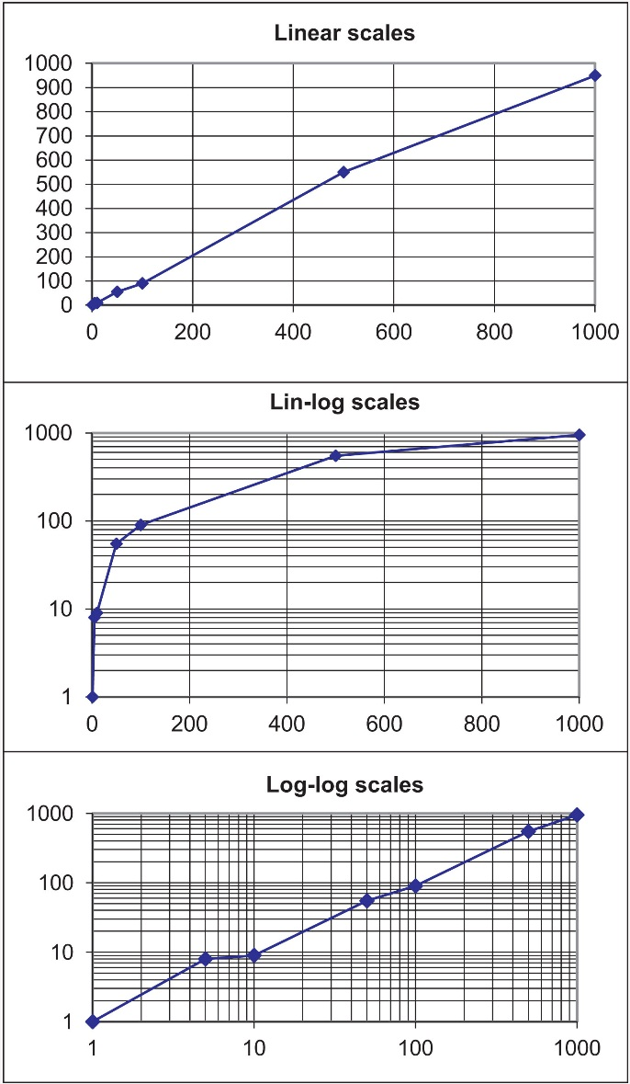
FIGURE 15.8 The Same Data on Linear and Log Scales

Slide 9
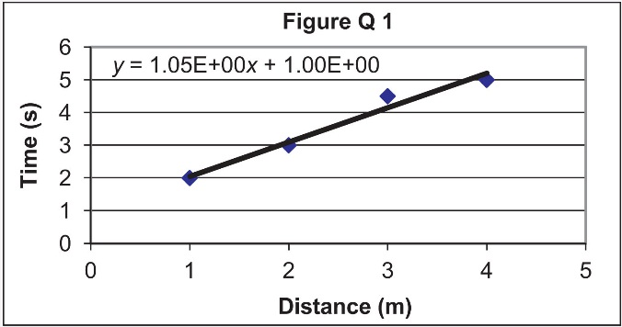

Slide 10
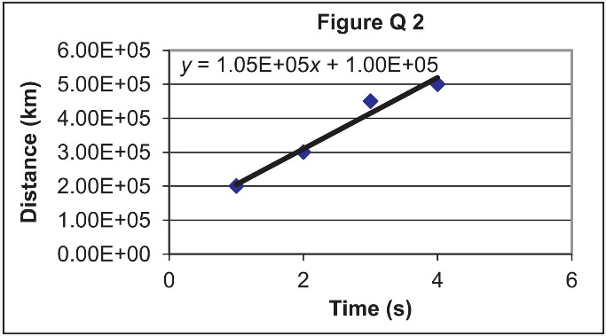

Slide 11
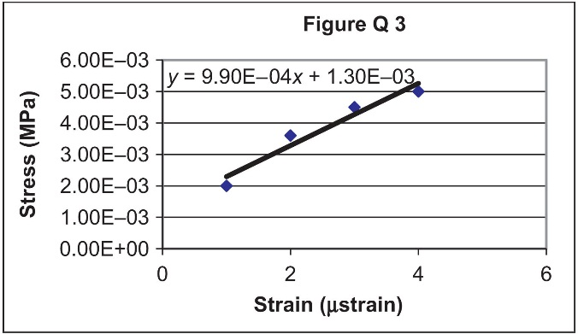

Slide 12
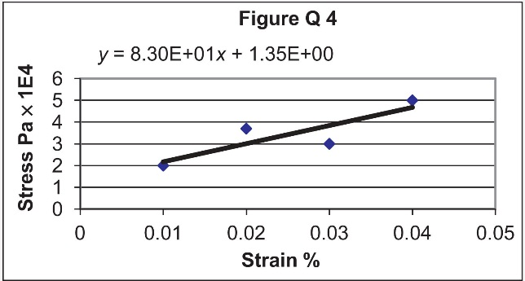

Slide 13
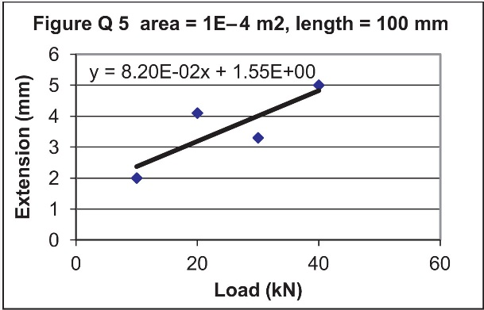

Slide 14
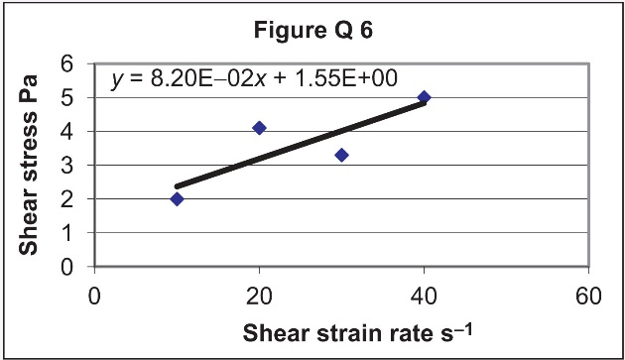

Slide 15
